Slide 1
JUKEVOTE
Cantón Fernández, Adrián
Carpio Camacho, Daniel
Fresno Aranda, Rafael
Rebollo Lobo, Pablo
Rodríguez Regidor, Juan

Slide 2

Business idea
Allow people to vote what music will be played in a pub or a disco.
Display in a map the places where this app is being used and additional information about the venue. People Will be able to know the music that is being played before entering a venue
Allow owners to organize raffles to encourage the participation of people inside the venue.

Slide 3
businESS IDEA
The principal source of income will be selling the license to use this app to venues owners.
Premium accounts with extra features may be implemented.
The main goal is to develop a web application, but later on a mobile application will make the voting process more appealing.

Slide 4

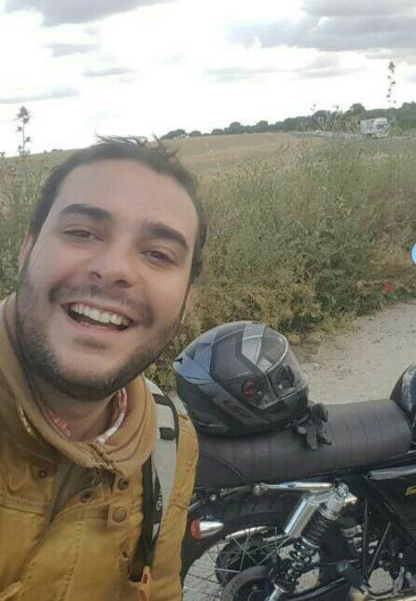
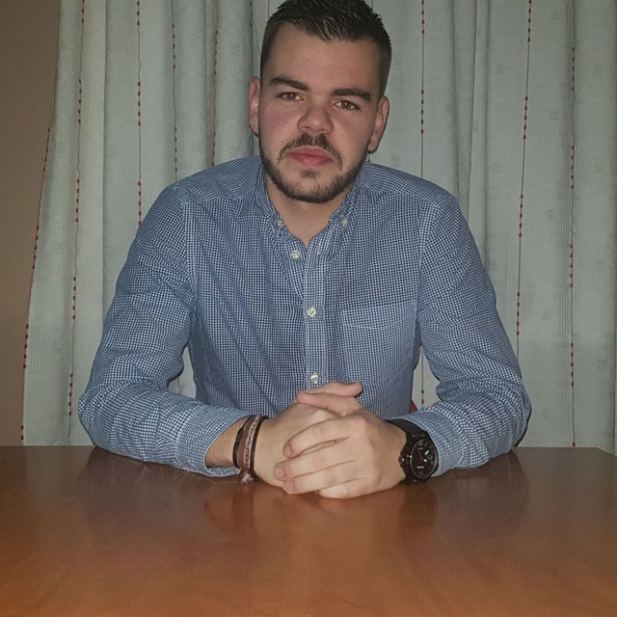


Our team
Adrián Cantón: Business management/Mobile application developer
Daniel Carpio: Analist/Frontend developer
Juan Rodríguez: Requirements engineer/Backend developer
Rafael Fresno: Backend developer/API integration
Pablo Rebollo: Backend developer/Project manager

Slide 5
Core requirements
3 types of users: owners, attendants and system administrators.
Our system will store data related to the venues where it is being used and their owners.
Owners will be able to customize the list of songs that will be played.
Owners will be able to register events in the application.
Attendants will receive a code they can use in order to vote which song they want to listen.
Attendants will be able to see information related to venues that use this application, such as their events and their geographical location.
Administrators can suspend an owner or attendant account when necessary.

Slide 6
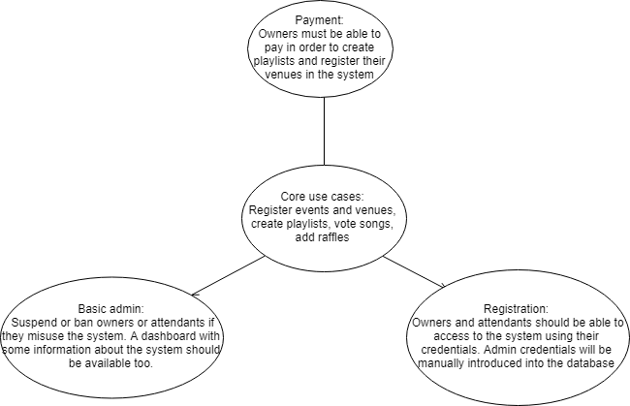
Mvp

Slide 7
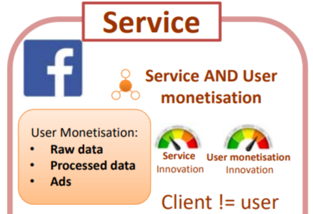
Mvp classification
Our software provides a service where our clients are not the users.
This software’s license will be sold to businesses that will tailor it to their own clients’ needs, who will be the main users of our app functionalities.

Slide 8
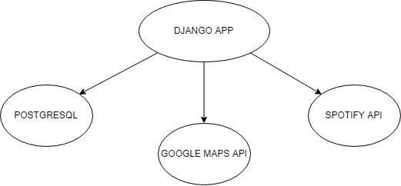
SYSTEM STRUCTURE
Option A:
Django app (Python), deployed in Heroku
PostgreSQL database, also deployed in Heroku
Spotify and Google Maps API

Slide 9
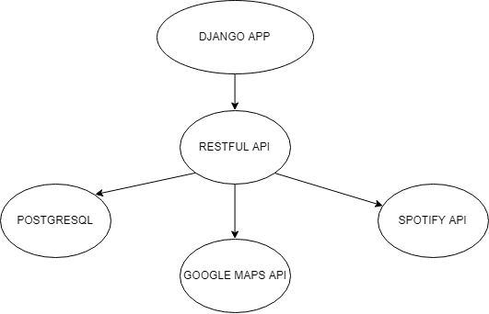
SYSTEM STRUCTURE
Option B:
Django app (Python), deployed in Heroku
RESTful API, in Django or Node.js, deployed in Heroku
PostgreSQL, also deployed in Heroku
Spotify and Google Maps API

Slide 10
OUR COMPETITORS
play.festa.co: Creates an empty playlist where people can add the songs they want from YouTube. It does not include any maps and the owner can’t create a fixed playlist.
http://yourlitzer.com: Similar to our proposal, but has no means of tracking the events that take place in the venues which use their software.

Slide 11

INNOVATION
JukeVote radically changes the way of listening to music in pubs, giving the clients the abilty to interact with the playlists in real time using the Spotify API.
By mapping the venues and giving information such as ongoing events or the type of music that is being played, the consumer will have an easier time deciding where to go.
Benefits for the owners such as not needing a DJ and increased exposure thanks to our app.
Mobile app in order to make the user experience as smooth as posible.

Slide 12
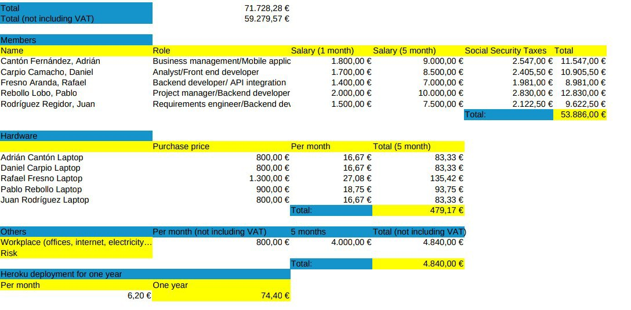
COSTS

Slide 13
Pilot users
Profiles we are looking for:
Young people
People with experience working in pubs and other kind of venues. Owners would be the best option, bartenders or DJs could also give a meaningful feedback

Slide 14
THANK YOU!

